Slide 1
PENETRATION TESTING
-Naveen

Slide 2
What is Penetration Testing?
Penetration testing is a type of security testing that is used to test the insecurity of an application. It is conducted to find the security risk which might be present in the system.
If a system is not secured, then any attacker can disrupt or take authorized access to that system. Security risk is normally an accidental error that occurs while developing and implementing the software. For example, configuration errors, design errors, and software bugs, etc.

Slide 3
Why is Penetration Testing Required?
Penetration testing normally evaluates a system’s ability to protect its networks, applications, endpoints and users from external or internal threats. It also attempts to protect the security controls and ensures only authorized access.
Penetration testing is essential because −
It identifies a simulation environment i.e., how an intruder may attack the system through white hat attack.
It helps to find weak areas where an intruder can attack to gain access to the computer’s features and data.
It supports to avoid black hat attack and protects the original data.
It estimates the magnitude of the attack on potential business.
It provides evidence to suggest, why it is important to increase investments in security aspect of technology

Slide 4
When to Perform Penetration Testing?
Penetration testing is an essential feature that needs to be performed regularly for securing the functioning of a system. In addition to this, it should be performed whenever −
Security system discovers new threats by attackers.
You add a new network infrastructure.
You update your system or install new software.
You relocate your office.
You set up a new end-user program/policy.

Slide 5
How is Penetration Testing Beneficial?
Enhancement of the Management System − It provides detailed information about the security threats. In addition to this, it also categorizes the degree of vulnerabilities and suggests you, which one is more vulnerable and which one is less. So, you can easily and accurately manage your security system by allocating the security resources accordingly.
Avoid Fines − Penetration testing keeps your organization’s major activities updated and complies with the auditing system. So, penetration testing protects you from giving fines.
Protection from Financial Damage − A simple breach of security system may cause millions of dollars of damage. Penetration testing can protect your organization from such damages.
Customer Protection − Breach of even a single customer’s data may cause big financial damage as well as reputation damage. It protects the organizations who deal with the customers and keep their data intact.

Slide 6
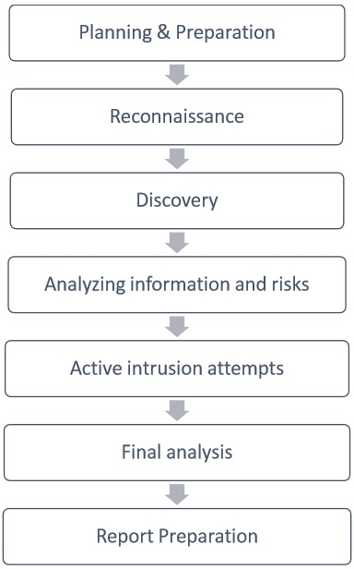
Penetration Testing - Method Steps Available in Penetration Testing Method

Slide 7
Method - 1 :Planning & Preparation
Planning and preparation starts with defining the goals and objectives of the penetration testing.
The client and the tester jointly define the goals so that both the parties have the same objectives and understanding. The common objectives of penetration testing are −
To identify the vulnerability and improve the security of the technical systems.
Have IT security confirmed by an external third party.
Increase the security of the organizational/personnel infrastructure.

Slide 8
Method - 2 : Reconnaissance
Reconnaissance includes an analysis of the preliminary information. Many times, a tester doesn’t have much information other than the preliminary information, i.e., an IP address or IP address block.
The tester starts by analyzing the available information and, if required, requests for more information such as system descriptions, network plans, etc. from the client.
This step is the passive penetration test, a sort of. The sole objective is to obtain a complete and detailed information of the systems.

Slide 9
Method – 3 :Discovery
In this step, a penetration tester will most likely use the automated tools to scan target assets for discovering vulnerabilities. These tools normally have their own databases giving the details of the latest vulnerabilities. However, tester discover
Network Discovery − Such as discovery of additional systems, servers, and other devices.
Host Discovery − It determines open ports on these devices.
Service Interrogation − It interrogates ports to discover actual services which are running on them.

Slide 10
Method – 4 : Analyzing Information and Risks
In this step, tester analyzes and assesses the information gathered before the test steps for dynamically penetrating the system. Because of larger number of systems and size of infrastructure, it is extremely time consuming. While analyzing, the tester considers the following elements −
The defined goals of the penetration test.
The potential risks to the system.
The estimated time required for evaluating potential security flaws for the subsequent active penetration testing.
However, from the list of identified systems, the tester may choose to test only those which contain potential vulnerabilities.

Slide 11
Method – 5 : Active Intrusion Attempts
This is the most important step that has to be performed with due care. This step entails the extent to which the potential vulnerabilities that was identified in the discovery step which possess the actual risks.
This step must be performed when a verification of potential vulnerabilities is needed.
For those systems having very high integrity requirements, the potential vulnerability and risk needs to be carefully considered before conducting critical clean up procedures.

Slide 12
Method – 6 :Final Analysis
This step primarily considers all the steps conducted (discussed above) till that time and an evaluation of the vulnerabilities present in the form of potential risks..
Further, the tester recommends to eliminate the vulnerabilities and risks.
Above all, the tester must assure the transparency of the tests and the vulnerabilities that it disclosed

Slide 13
Method – 7 : Report Preparation
Report preparation must start with overall testing procedures, followed by an analysis of vulnerabilities and risks. The high risks and critical vulnerabilities must have priorities and then followed by the lower order.
However, while documenting the final report, the following points needs to be considered −
Overall summary of penetration testing.
Details of each step and the information gathered during the pen testing.
Details of all the vulnerabilities and risks discovered.
Details of cleaning and fixing the systems.
Suggestions for future security.

Slide 14
Penetration Testing Vs. Vulnerability
Penetration Testing and Vulnerability assessment are used interchangeably by many people, either because of misunderstanding or marketing hype. But, both the terms are different from each other in terms of their objectives and other means. However, before describing the differences, let us first understand both the terms one-by one.
Penetration Testing replicates the actions of an external or/and internal cyber attacker/s that is intended to break the information security and hack the valuable data or disrupt the normal functioning of the organization. So, with the help of advanced tools and techniques, a penetration tester (also known as ethical hacker) makes an effort to control critical systems and acquire access to sensitive data.

Slide 15
Vulnerability Assessment
A vulnerability assessment is the technique of identifying (discovery) and measuring security vulnerabilities (scanning) in a given environment.
It is a comprehensive assessment of the information security position (result analysis).
It identifies the potential weaknesses and provides the proper mitigation measures (remediation) to either remove those weaknesses or reduce below the risk level.

Slide 16
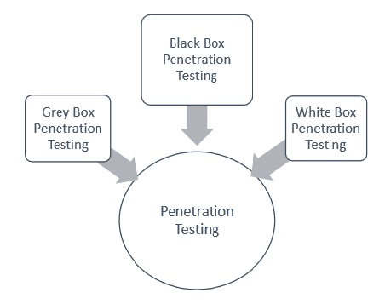
Types of Penetration Testing
It is also known as Pen Testing.
Following are the important types of pen testing :
(1)Black Box Penetration Testing
(2)White Box Penetration Testing
(3)Grey Box Penetration Testing

Slide 17
Black Box Penetration Testing
In black box penetration testing, tester has no idea about the systems that he is going to test. He is interested to gather information about the target network or system. For example, in this testing, a tester only knows what should be the expected outcome and he does not know how the outcomes arrives. He does not examine any programming codes.
Advantages of Black Box Penetration Testing :
(1)Tester need not necessarily be an expert, as it does not demand specific language knowledge
(2)Tester verifies contradictions in the actual system and the specifications
(3)Test is generally conducted with the perspective of a user, not the designer
Disadvantages of Black Box Penetration Testing :
(1)Particularly, these kinds of test cases are difficult to design.
(2)Possibly, it is not worth, incase designer has already conducted a test case.
(3)It does not conduct everything.

Slide 18
White Box Penetration Testing

Slide 19
White Box Penetration Testing

